Slide 1

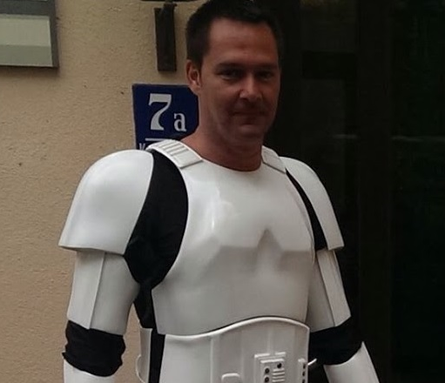
Deep Dive on AWS DevOps CI/CD Tooling
Wolfgang Unger
AWS Solutions architect | INSTRUCTOR
DevOps concepts, best practices and how to use AWS CodeCommit, CodeBuild, CodeDeploy and CodePipeline.

Slide 2

Deep Dive on AWS DevOps CI/CD Tooling
Wolfgang Unger
AWS Solutions Architect | instructor

Slide 3


Course overview
Introduction
Deep Dive on AWS DevOps CI/CD Tooling
Course Overview
CodeCommit
CodeBuild
CodeDeploy & CodePipeline
Summary
Wolfgang Unger
AWS |Solutions Architect | Instructor

Slide 4

Course overview
1
CodeCommit
A version control service hosted by Amazon Web Services that you can use to privately store and manage files, such as documents, source code, and binary files in the cloud
2
CodeBuild
A fully managed continuous integration service that compiles source code, runs tests, and produces software packages that are ready to deploy
3
CodeDeploy & CodePipeline
a fully managed deployment service that automates software deployments to a variety of compute services such as Amazon EC2, AWS Fargate, AWS Lambda, and your on-premises servers and a fully managed continuous delivery service that helps you automate your release pipelines for fast and reliable application and infrastructure updates

Slide 5
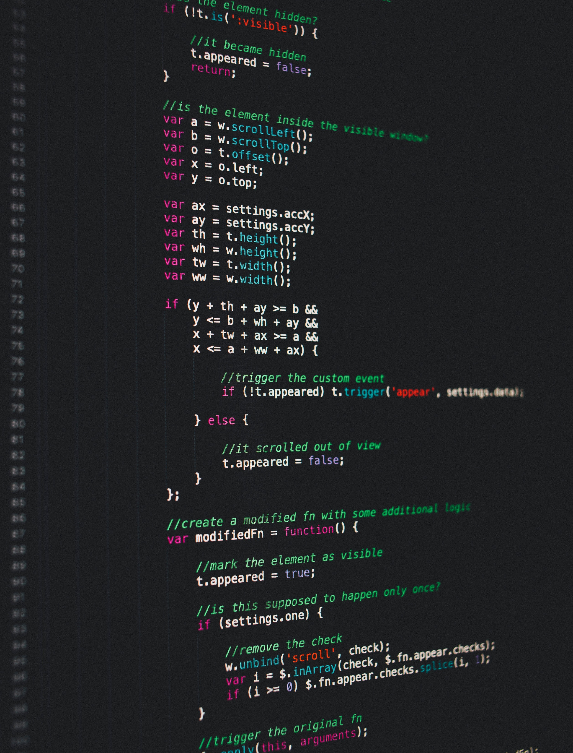
CodeCommit
Introduction and chapter overview
Create first CodeCommit Repo
Browse files in Repo
Integration with Eclipse and VisualStudio
Triggers and webhooks
Branches
Pull requests
Summary
Notes:
Karel Capek, a Czech novelist introduced and made popular the word robot as a word for artificial human beings. It first appeared in his play R.U.R. (Rossum’s Universal Robots) in 1920. In Czech, the word means worker or servant.

Slide 6

CodeBuild
Introduction and chapter overview
Providers
First CodeBuild project
Docker example project
Input sources and output artifacts
Static website example project
Lambda example project
Monitoring codebuild
Env variables
Summary
Notes:
Karel Capek, a Czech novelist introduced and made popular the word robot as a word for artificial human beings. It first appeared in his play R.U.R. (Rossum’s Universal Robots) in 1920. In Czech, the word means worker or servant.

Slide 7

CodeDeploy und CodePipeline
Introduction and chapter overview
First pipeline with CodeCommit repo
Create ECS deploy pipeline
Create a pipeline with cloud formation
Create android app pipeline
Stages
Cloudwatch events, webhooks and change triggers
Summary
Notes:
Karel Capek, a Czech novelist introduced and made popular the word robot as a word for artificial human beings. It first appeared in his play R.U.R. (Rossum’s Universal Robots) in 1920. In Czech, the word means worker or servant.

